Slide 1
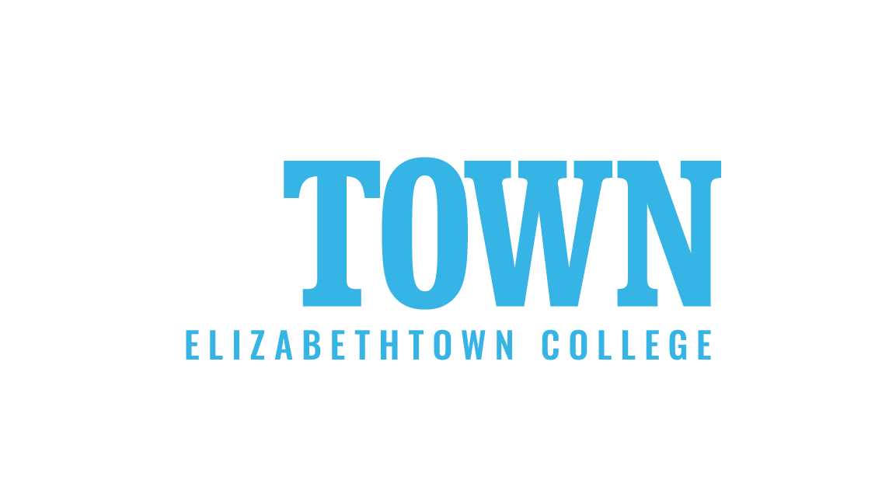

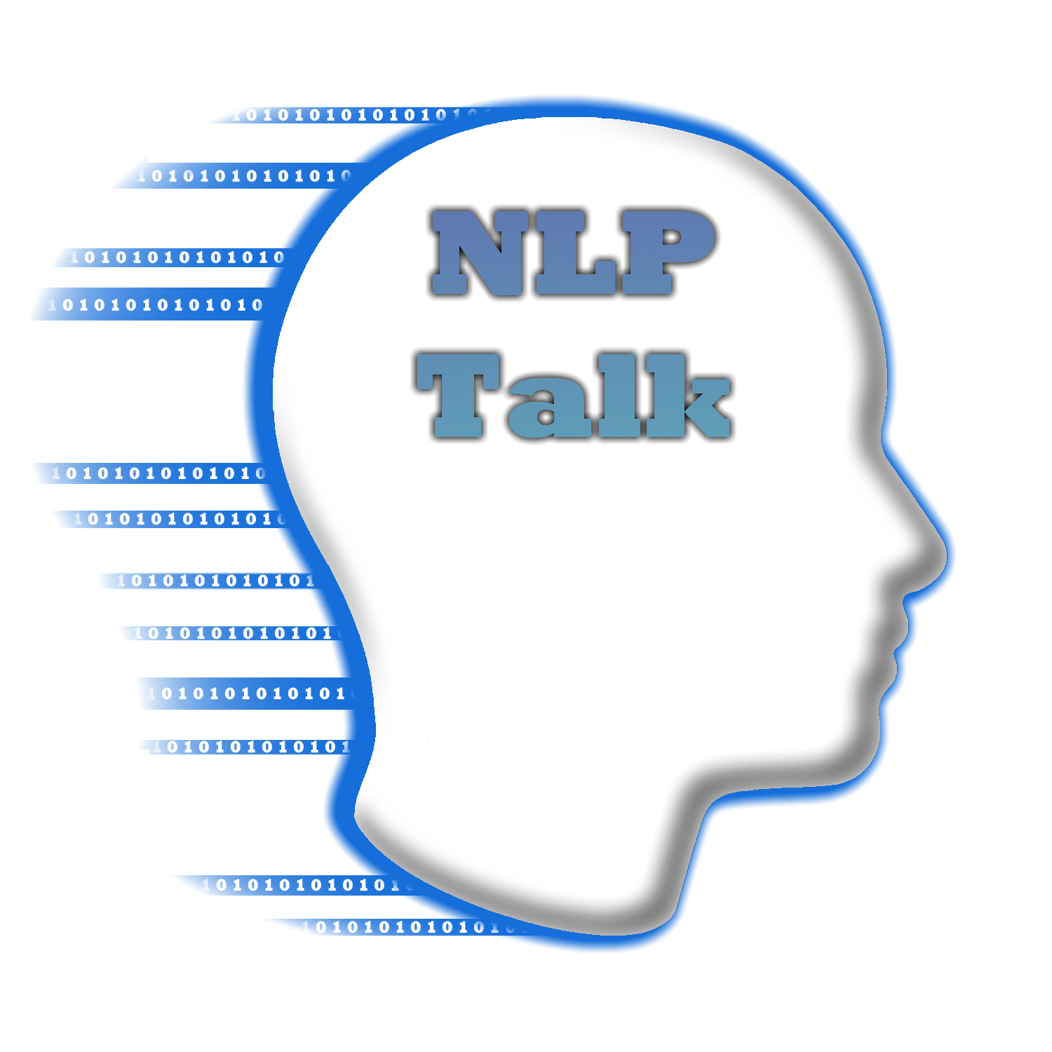
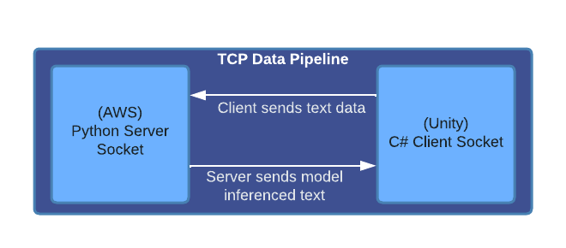
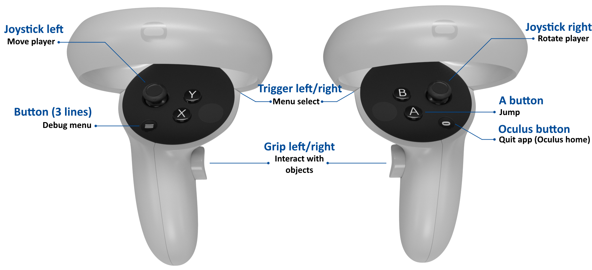
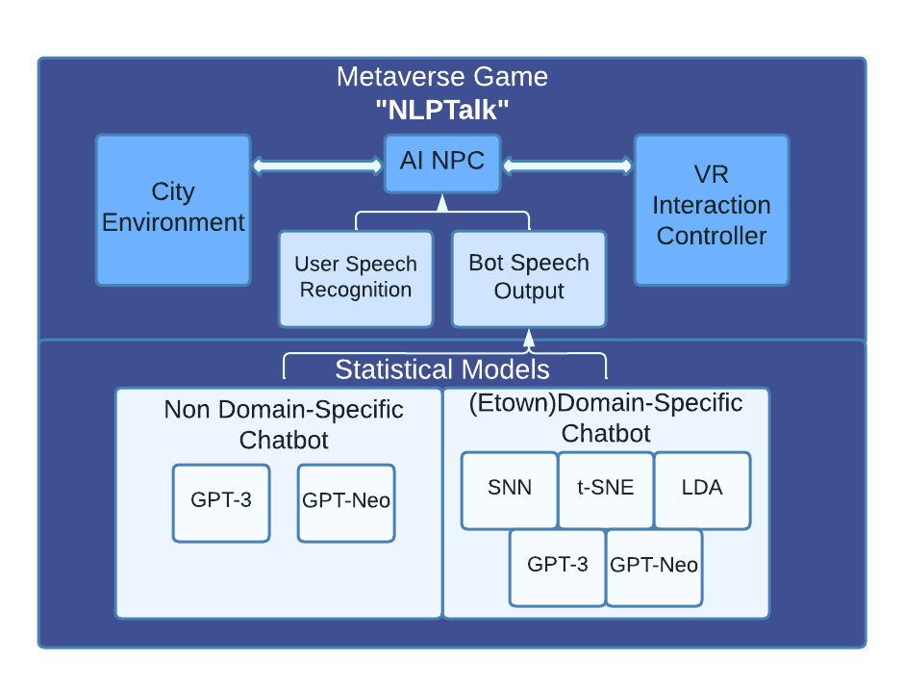
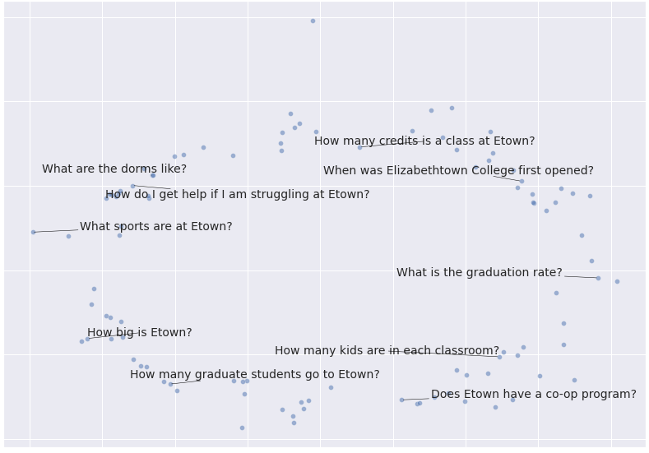
Natural Language Processing in the Metaverse (NLPTalk)
Matthew Grohotolski
Dr. Peilong Li
OPPORTUNITY
There is a clear disconnect between user interactions within applications / game worlds which becomes appearant when playing in current Virtual Reality apps.
Recent advancements in VR hardware and Cloud Computing afford the opportunity to implement uniquely crafted solutions to these problems to immerse users into the applications and games they play.
TECHNICAL DESIGN
The TCP network protocol is utilized and implemented to allow users in-game to communicate with the statistical back-end models programmed in Python. This ensures every packet is delivered and no data is lost along the way.
PROTOTYPE/DEVICE/PROCESS
Since the project utilizes the Meta Quest 2 VR headset for fully wireless immersion, many optimizations had to be made to support the mobile processor within the hardware. This does little to subtract from the overall experience of interacting with the chatbot and greatly improves performance as a result of the optimizations applied.
A full list of controls for the game can be seen on the right. Once in-game, the user can walk up to the chatbot agent and begin immediately asking questions while in range of the bot. Adjusting the dial next to the agent will swap the current model being used to calculate inference results on the Python server.
Figure 2: TCP Data Pipeline Shows the network data pipeline stack
DESIGN SPECIFICATIONS
The project design features a VR game to showcase the several implemented Machine Learning & Deep Learning models. Speech Recognition software is utilized within the Unity game to automatically parse user input which is then passed to the inference models.
After model inference has been conducted, the result is spoken back to the user in real time
Several NLP models were implemented and trained with two custom datasets to achieve the goal of answering college-specific questions asked by the user.
Clustering
Siamese Neural Network (SNN)
t-Distributed Stochastic Neighbor Embedding (t-SNE)
Latent Dirichlet Allocation (LDA)
Transformer
GPT-3
GPT-3-Etown
GPT-Neo
GPT-Neo-Etown
Figure 3: Control Scheme Describes the basic controls within the Unity game for demonstration purposes
TESTING
Models were evaluated based on two factors; 1.) the question asked to the bot and 2.) the resulting inference text produced by the bot.
Through initial testing, the Transformer models appear to outperform the Clustering models. Both types are easily trainable with custom datasets and offer great results. Each category contains its own strengths and weaknesses such as the Transformer models trading unique full sentence output results for slightly longer inference speeds and vise versa for Clustering techniques. As of this project, the GPT-3 models also require monetary input in the form of openai credits to process results, while GPT-Neo models and all researched Clustering models are free and open source
Participants who interact with the chatbot will have the chance to further score each model’s performance.
IMPACT
Natural Language Processing will become a status quo in coming years.
This project will set new standards for using NLP in applications and games as technology continues to evolve and the Metaverse gains more traction.
REFERENCES AND ACKNOWLEDGEMENTS
[1] https://beta.openai.com
[2] https://github.com/EleutherAI/gpt-neo
[3] https://medium.com/@prabhnoor0212/siamese-network-keras-31a3a8f37d04
Thank you to Luke Moynihan for assisting with custom dataset creation and model implementation.
Also special thanks to Dr. Peilong Li and the ECMS department for sponsoring the project and providing the necessary Meta Quest 2 hardware for testing and demonstration purposes.
The project files and game executable can be found at: https://github.com/MattGroho/NLPTalk
Figure 1: Project Overview Displays the overarching project structure and development pipeline.
Figure 2: t-SNE Clusters Displays the output of the trained t-SNE statistical model clustering results
Capstone Project 2022
EDUCATE FOR SERVICE. ENGINEER FOR SOCIETY.

